Slide 1
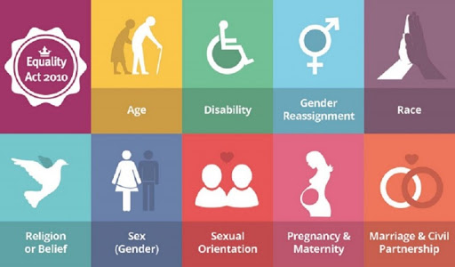
2010 Equality Act

Slide 2

What is it?
The Equality Act was a law introduced by the UK government on 1st October 2010, it was made so that minority groups would be protected by law from discrimination

Slide 3

What characteristics does it protect?
Age
Sex
Gender reassignment
Being married/in a civil partnership
Disability
Pregnancy
Race
Religion

